Slide 1



CDA Document Summary Section
Presented by Emma Jones, Daniel Venton, George Dixon - Allscripts

Slide 2
The Problem(s)
Current CDA content profiles do not capture a concise synopsis about the document that the author need to communicate to the reader (e.g. provider to provider and/or to the patient).
Some CDA documents contain elements with linkages to other elements that is often not represented in a way that effectively portrays the clinical picture.
CDA documents often contains large amounts of information that makes it difficult to identify pertinent information in an efficient way.

Slide 3
Technical Approach
Provide a concise summary section of a document:
Based on specific user expectations (i.e. what the user want to ‘explain’ or synopsis the user wants to provide) – see Use Case 1
Representing information populated from data in the applicable sections to portray the clinical picture or to quickly call attention to the most pertinent information – See Use Case 2, 3, 4, 5

Slide 4
CDA Document
Care Plan Summary (with nested elements)
New Optional CDA Summary Section
CDA Document Sections
Health Concern Section
Goals Section
Interventions Section
Outcomes Section

Slide 5
1. Specified user expectations
Existing Templates
IHE Document Summary Section (text only section)
Template ID 1.3.6.1.4.1.19376.1.4.1.2.16
C-CDA 2.1 Notes Section (has structured entry)
Template ID urn:hl7ii:2.16.840.1.113883.10.20.22.2.65:2016-11-01
Note Activity entry [1..*]
Template ID urn:hl7ii:2.16.840.1.113883.10.20.22.4.202:2016-11-01
Author Participation
Encounter Activity
Provide the user specified expectations (i.e. what the user want to ‘explain’ or synopsis the user wants to provide).

Slide 6
2. Representing pertinent information from data in the applicable sections to (a) portray the clinical picture (e.g. Care Plan) or to (b) quickly call attention to the most pertinent information. The new ‘summary section’ is auto-populated from data in the applicable sections. This will ensure that the end user is not required to do any additional data entry.

Slide 7
2 (a). Representing pertinent information from data in the applicable sections to portray the clinical picture (e.g. Care Plan)

Slide 8
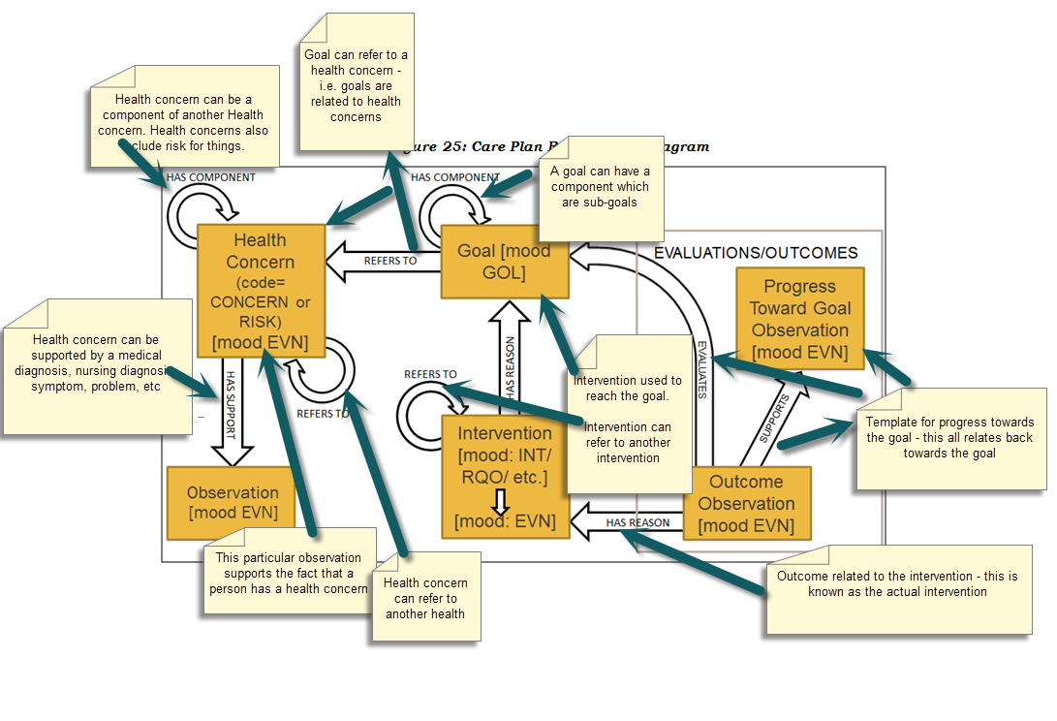
Care Plan Concepts
C-CDA 2.1

Slide 9
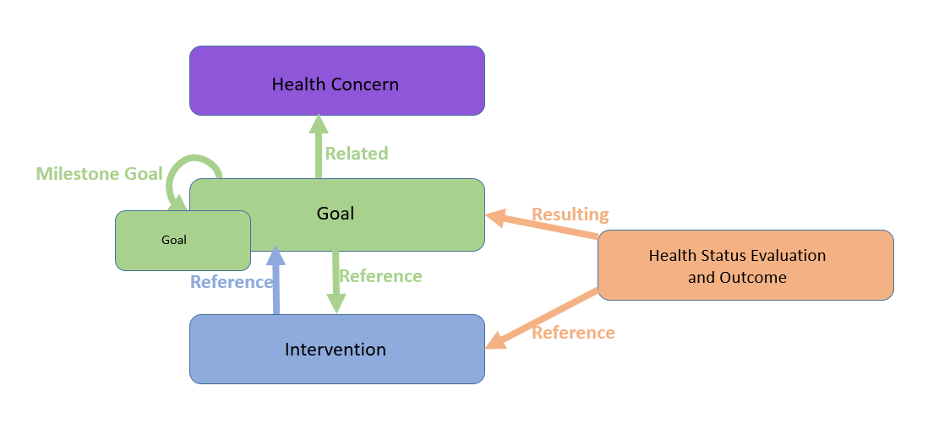
Care Plan Concepts
C-CDA 2.1
Notes:
Slim-down view between the Care Plan DAM, the Vol 1 (appendix E) picture, and the C-CDA R2.1 Care Plan sections.

Slide 10
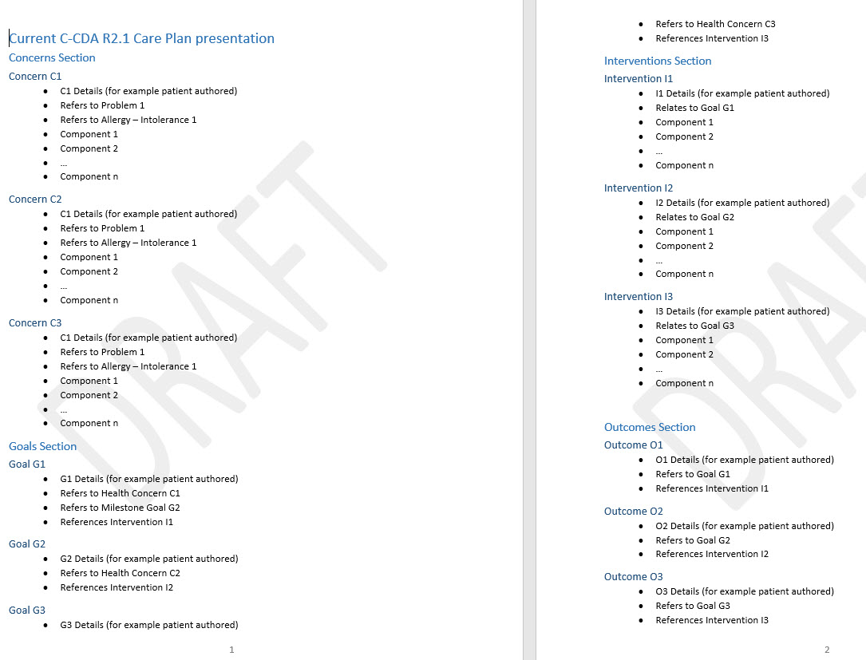
The black box shows current outline of care plan document, with sections, each containing text about the entries in the section.

Slide 11
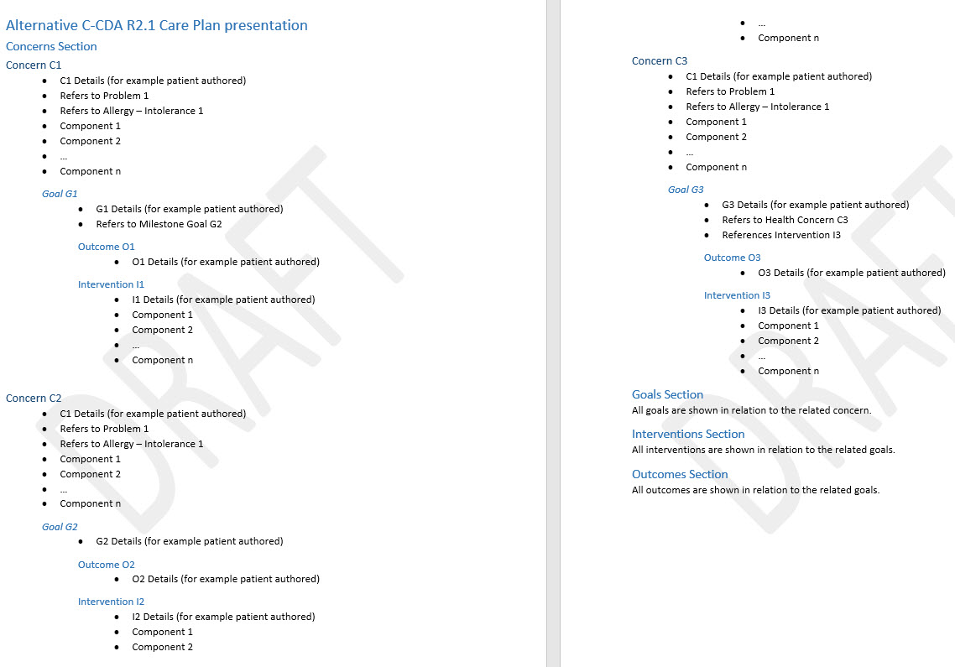
The yellow box is the proposed: move the goals, outcomes and intervention text (generated from the applicable sections) to the related Concern in the Concerns Section.

Slide 12
Proposed - Patient is type 1 diabetic, well controlled. Concern r/t development of retinopathy.
Concern: Potential for diabetic retinopathy.
Goal: Maintain HgA1C < 7mg/dl
Intervention: Exercise 3 x per week, one hour each.
Outcome: Patient reports inconsistent pattern (goal not achieved)
Intervention: monitor glucose AM, PM and before meals.
Outcome: Patient reports always checks in Am and before bed with checks prior to meals. (goal achieved)
Intervention: Adjust insulin per carbohydrate intake and pump guidance.
Outcome: Patient reports compliance (goal achieved)
Outcome: 2016.06.15 HgA1C = 7.1 (goal not achieved)
Outcome: 2016.09.20 HgA1C = 6.3 (goal achieved)
Goal: Maintain regular eye exams
Intervention: Schedule and maintain yearly eye exams (Complete)
Outcome: Patient reports initial appointment scheduled. (goal achieved)
Outcome: 2016.05.23, retinal specialist report indicates minor proliferative vessel growth, will monitor every 6 month.
Intervention: Follow retinal specialist recommended interval, adjust as needed.
Auto-populate rule: Health Concerns with goals, outcomes and/or interventions included in the document
Notes:
An example of what a care plan might look like utilizing the alternate human readable text approach. Auto-pop rules for

Slide 13
2(b) Describe pertinent information about specific content in the document - auto-populated from data in the applicable sections .
Identify specific use cases
Summary section listing active problems, active medications, allergies
Summary section containing discharge specific information – Discharge diagnosis, discharge medications, discharge instructions
Summary section containing pertinent information changed during a specified encounter
Summary section containing active/planned medications
Auto-populate rule: (1)Active medications, active problems or allergies (2) Discharge specific information (3) Encounter specific information (4) Active/Planned medications

Slide 14
Actors
New Actor(s)
No new actors
Existing Actor(s)
Content Creator
Content Consumer

Slide 15
Transactions
New Transactions
No new transactions

Slide 16
Use Case 1
‘Synopsis’ Section –
Provide a brief cover note that one provider writes to the next provider. This provides a place for the document author to explain the purpose of the document, what should be done, what portions or items in the document should get special attention, etc.

Slide 17
Use Case 2, 3, 4
‘Pertinent Information’ Section –
Provides summary information about specific content in the document. Examples include –
Pertinent discharge information
Pertinent encounter specific information
Active problems, medications, allergies
Active/Planned medications

Slide 18
Use Case 5
Care Plan Nesting Summarization –
Consolidated CDA Care Plan document provides the ability to link entry templates together to tell the care planning story.
IHE PCC Patient Care Plan Profile provides the ability to nest sections within sections
Providing an easy view of how care plan components are linked and nested, without forcing the traversing across various sections, will be very helpful to the user.
User is still able to view the entire document if needed.

Slide 19
Standards & Systems
Standards
CDA R2
IHE PCC Medical Document
Consolidated CDA
FHIR HTML Rendering???
Systems
EHR
PHR
Patient Portal
HIE

Slide 20
Discussion
Provide a concise view of a document based on a summary of specific user expectations can be time saving for a provider.
Provide a way to reflect what the patient need to see so that the large amount of information in the CDA document is provided but at the same time not become overwhelming.
Depending on use case, a Summary Section can be added to a document, summarizing pertinent information populated by some of the data in the various sections to create a composite, single Summary section.
A summary section can also be used for the author of the document to describe pertinent information about the document
Further exploration and discussion.
Keep as one profile
Use different options on the actors
Be able to distinguish between sender and receiver
Make section optional
Discuss should or may conformances
Group use cases - 1. precise message from one provider to another 2) Summary generated from data in the document for specific use

Slide 21
Questions?
Synopsis: could this be something that can go in xds description?
Would this expose PHI?
How is this going to succeed with existing efforts for similar profiles? e.g. Cardiology procedure note (document summary section – concise narrative); C-CDA 2.1 Notes Section
Proposal captures multiple problems – should we treat as multiple work items? Need to determine how to structure this. Describe each problem separately.

